Slide 1

Autonomous Response System for
SOC ( Security Operation Centre)
An AI triage assistant that adapts to how busy the security team is.
Team:
Muhammad Daniyal (2023406)
Muhammad Haider Iqbal (2023416)
Syed Daud (2023677)
Supervisor: Dr. Muhammad Fawad Khan
Co-Supervisor: Miss Hadia Abbas
BS Cybersecurity, FCSE, GIKI

Slide 2
What Is a SOC?
Alert
A security tool flags something suspicious.
SOC
The team of analysts who check those alerts.
Triage
Deciding: real threat or false alarm, and what gets looked at first.
In short: Tools raise alerts, analysts check them, and triage decides which get attention first.
SIEM = the dashboard where alerts arrive (e.g., Splunk).

Slide 3
The Problem
Modern security tools are continuously detecting threats, but a SOC team struggles to keep up with the alerts being generated.
51% of SOC teams report feeling overwhelmed by alert volume.
49% of assigned alerts get resolved within a workday.
78% of companies cut 50%+ SOC staffing on weekends and holidays.
52% of surveyed organizations reported ransomware targeting during weekends and holidays.
If detection works, why are alerts still going unattended?
Tariq, S., Baruwal Chhetri, M., Nepal, S., & Paris, C. (2025). Alert fatigue in security operations centres: Research challenges and opportunities. ACM Computing Surveys, 57(9), 1-38.
Semperis. (2025). 2025 ransomware holiday risk report. https://www.semperis.com/wp-content/uploads/resources-pdfs/reports/resources-semperis-ransomware-holiday-risk-report.pdf

Slide 4
Project Idea and Motivation
ARSS checks the SOC's current workload before Triaging an alert: incoming alerts, team’s capacity, backlog, and available analysts.
The same alert can receive a different response depending on the team's current capacity and type of day.
Alert triage is the process of reviewing security alerts as they arrive and deciding which are
Real threats
False alarms
Which need action first.
Most triage systems treat every alert the same, whether the team is busy or free
ARSS adjusts to the team's current workload and addresses this Gap.

Slide 5
The Proposed Solution
ARSS conditions alert triage on the SOC’s current workload.
It evaluates alert risk together with the current SOC state, rather than treating every alert independently.
Based on these inputs, ARSS can:
Auto Close
Close it
automatically
Defer
Put it in a Queue
Escalate
Send it to a human right now
A hard severity floor ensures high-severity alerts are always escalated to a human, regardless of workload.

Slide 6
Closest work done
AI-Driven Alert Triage in Security Operations Centers: Imbalanced Learning with Human-in-the-Loop Contextual Bias Modeling
Only suggests a decision to a human, doesn't decide on its own
Handles just two simple yes/no decisions. not very detailed
Built for managed SOCs (where a company handles security for other clients) — may not work the same for a normal in-house SOC
Not clear if it was tested on real, live alerts or just old recorded data confirmed
A human-facing recommendation system limited to two coarse yes/no decisions, built for managed-SOC client-reporting workflows, with no clear evidence it was validated on live alerts rather than old data.
Lázaro, Marcelino, et al. "AI-Driven Alert Triage in Security Operations Centers: Imbalanced Learning with Human-in-the-Loop Contextual Bias Modeling." IFIP International Conference on Artificial Intelligence Applications and Innovations. Cham: Springer Nature Switzerland, 2026.

Slide 7
Closest work done
Finding needles in a moving haystack: Prioritizing alerts with adversarial reinforcement learning
Budget is a fixed constant, never observed by the policy as live input
Alert queue resets every period, no accumulating backlog
The "20%" figure is best-of-4 categories, and drops to zero under cheap, frequent feint attacks
Uses DDPG, built for continuous action spaces — doesn't directly fit discrete setups (like close/queue/escalate)
A fixed-budget, resetting-queue model built for continuous action spaces, whose headline "20% risk reduction" is a best-case number that drops to zero under cheap, frequent attacks.
Tong, Liang, et al. "Finding needles in a moving haystack: Prioritizing alerts with adversarial reinforcement learning." Proceedings of the AAAI Conference on Artificial Intelligence. Vol. 34. No. 01. 2020.

Slide 8
Scope
Simulated SOC workload environment
Six alert-triage methods compared under the same conditions
Dynamic SOC workload state: demand, capacity, backlog, analyst availability, Utilization, Recent Workload
Hard severity floor for high-severity alerts
Splunk as the primary SIEM target

Slide 9
Complex Computing Problem Alignment
# | Attribute | Justification
1 | Range of conflicting requirements | Reducing analyst workload can conflict with maintaining security.
2 | Depth of analysis required | Six triage methods are compared because no single approach is assumed optimal.
3 | Depth of knowledge required | Combines cybersecurity, machine learning/RL, and SOC workload modeling.
4 | Familiarity of issues | Existing work addresses alert automation, but workload-conditioned triage remains insufficiently explored.
5 | Level of problem | Requires integration of alert processing, SOC-state modeling, decision policy, and feedback.
6 | Consequences | Incorrect triage can increase analyst burden or delay response to genuine threats.
7 | Interdependence | Each component affects subsequent decisions, workload state, queue evolution, and feedback.

Slide 10

SDG Alignment
SDG 9 — Industry, Innovation & Infrastructure
Advances cybersecurity research through an innovative workload-aware alert-triage system.
SDG 16 — Peace, Justice & Strong Institutions
Supports stronger institutional cybersecurity through more effective security-operations processes.
SDG 8 — Decent Work & Economic Growth
Investigates whether workload-aware can improve SOC analyst productivity and workload sustainability.

Slide 11
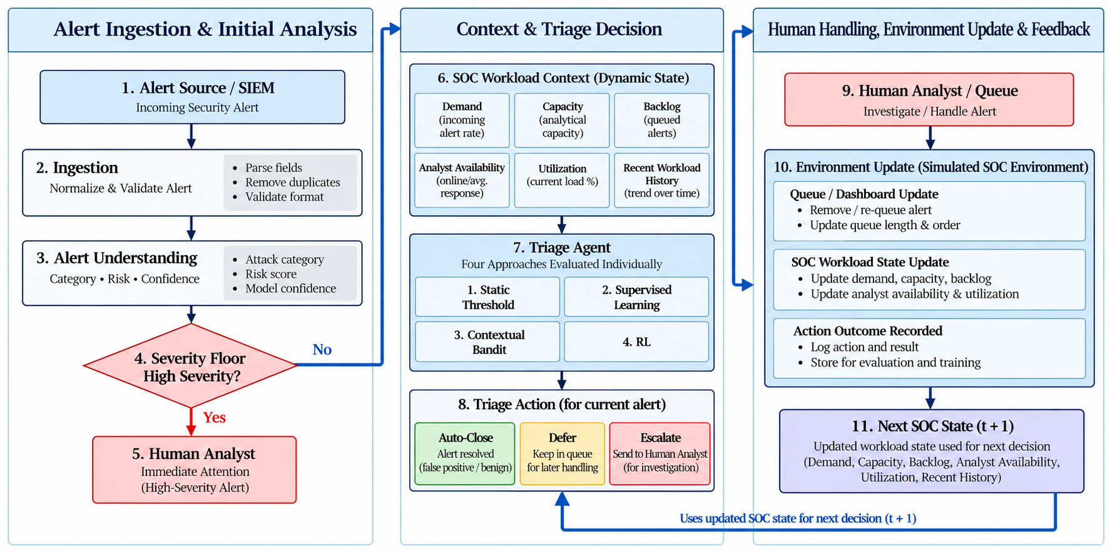
How It Works
6
6

Slide 12
What We're Delivering
Research System - A simulated SOC environment with workload-aware alert triage.
Comparative Evaluation - Six triage approaches evaluated under the same workload conditions.
Working Prototype - ARSS implementing alert understanding, severity protection, workload state, and adaptive triage.
Research Outcome - Evidence showing whether workload-conditioned triage can reduce analyst burden without increasing missed high-severity alerts.
Evaluation Evidence - Measured results across workload, queue behavior, response performance, and security outcomes.

